Slide 1
CDMA Transmission Jamming Queue Theory
Bartolomeo Elia Giovanni Rescinito Giuseppe Seccia

Slide 2
Agenda
Jamming
Jammer Types
Simulations
2
CDMA
PN Codes
M-Sequence
Simulations
Queue Theory
M/M/K
Simulation
1
3

Slide 3
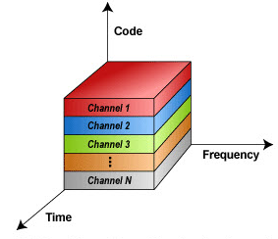
Code Division Multiple Access
Common multiple access protocol used for wireless communications.
The first aim of CDMA was to solve two problems in military field:
Limit enemy capability to interfere radio signal (jamming).
Prevent detection of communication (noise-like signals).
Initial signal bandwidth is spreaded into a larger one.
More users work at same frequencies.
Users can be identified with unique codes with some properties (“pseudo-random codes”)
Direct Sequence Spread-Spectrum is used as transmission technique.

Slide 4
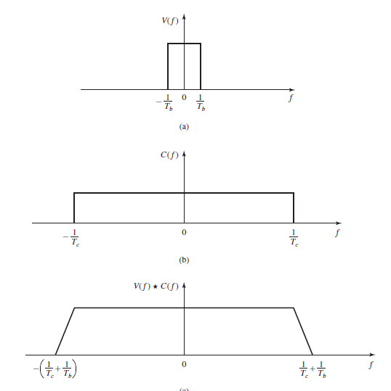
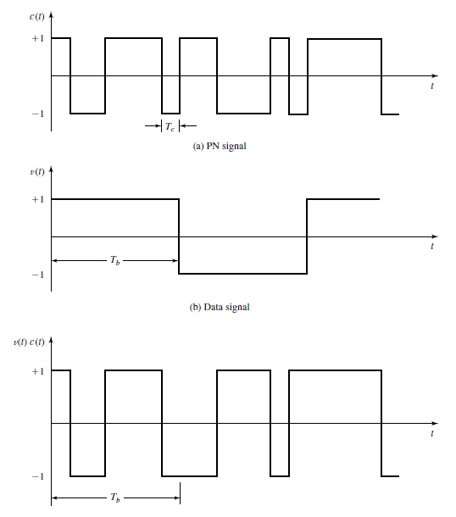
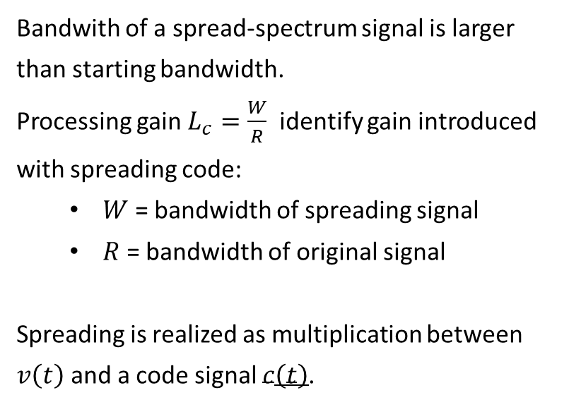
Direct Sequence Spread-Spectrum
Bandwith of a spread-spectrum signal is larger than starting bandwidth.
Processing gain $L_{c}=\frac{W}{R}$ identify gain introduced with spreading code:
$W$ = bandwidth of spreading signal
$R$ = bandwidth of original signal
Spreading is realized as multiplication between $v\left(t\right)$ and a code signal $c\left(t\right)$.

Slide 5
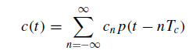
Code Generation and PN-Sequences
Pseudo-Noise codes properties:
Two levels of values
High signals auto-correlation in order to identify them.
Low signals cross-correlation in order to let more users communicate over same frequencies.
Balanced (difference between high-values and low-values is 1) in order to spread signal energy.
Code types:
Orthogonals: Walsh Sequences
Non-orthogonali (Long Shift Register Sequences):
M-Sequences
Gold Codes
Kasami Codes

Slide 6
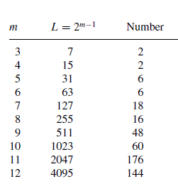
M-Sequences
Maximum length sequences
Implemented with LFSR.
Prime m-degree polynomes as sequence generator.
[0 0 0 ... 0 1] starting LFSR condition.
L = 2^(m-1) is the length of the sequence.

Slide 7
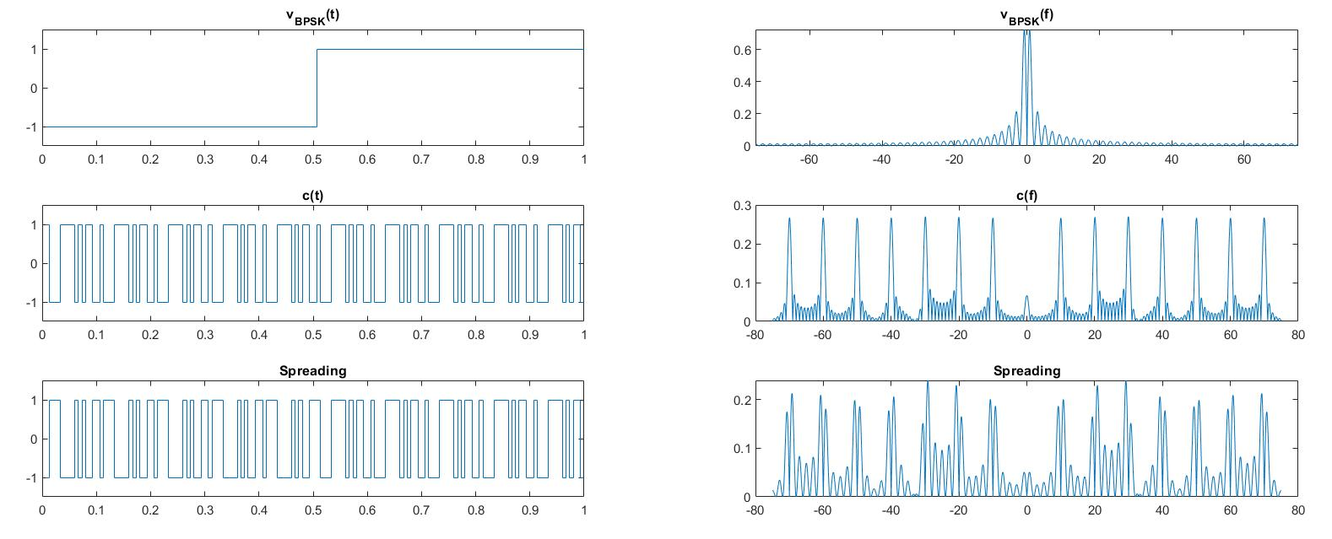
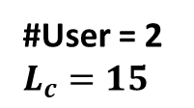
Single CDMA Transmission Simulation
#User = 2
$$L_{c}=15$$

Slide 8
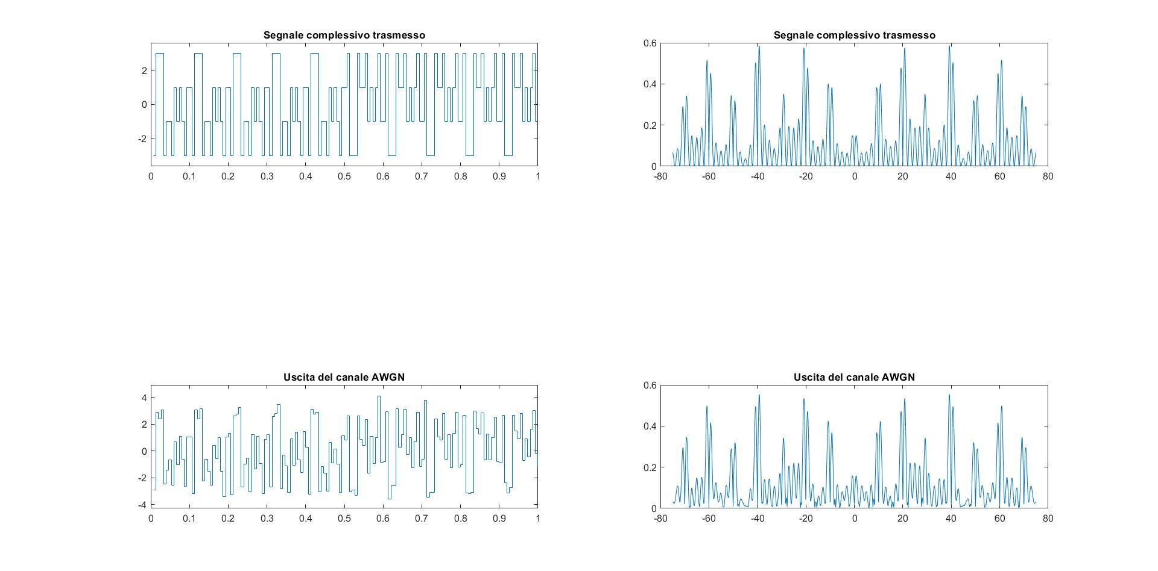
Single CDMA Transmission Simulation

Slide 9
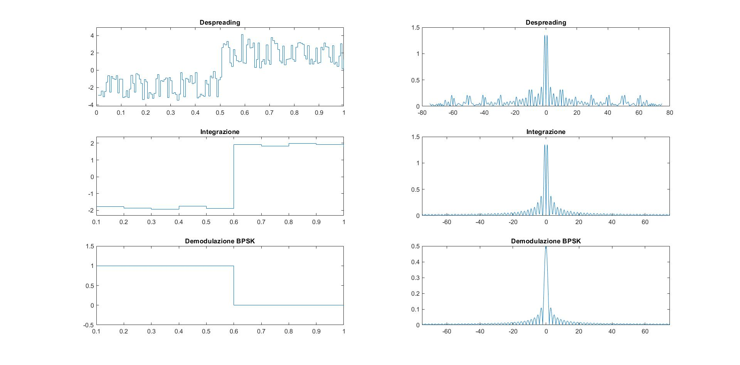
Single CDMA Transmission Simulation

Slide 10
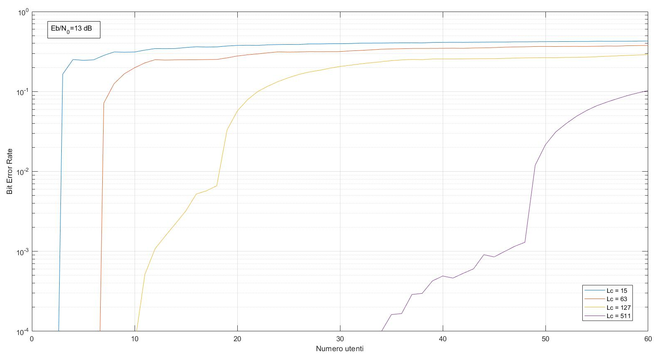

BER varying $L_{c}$and #Users

Slide 11
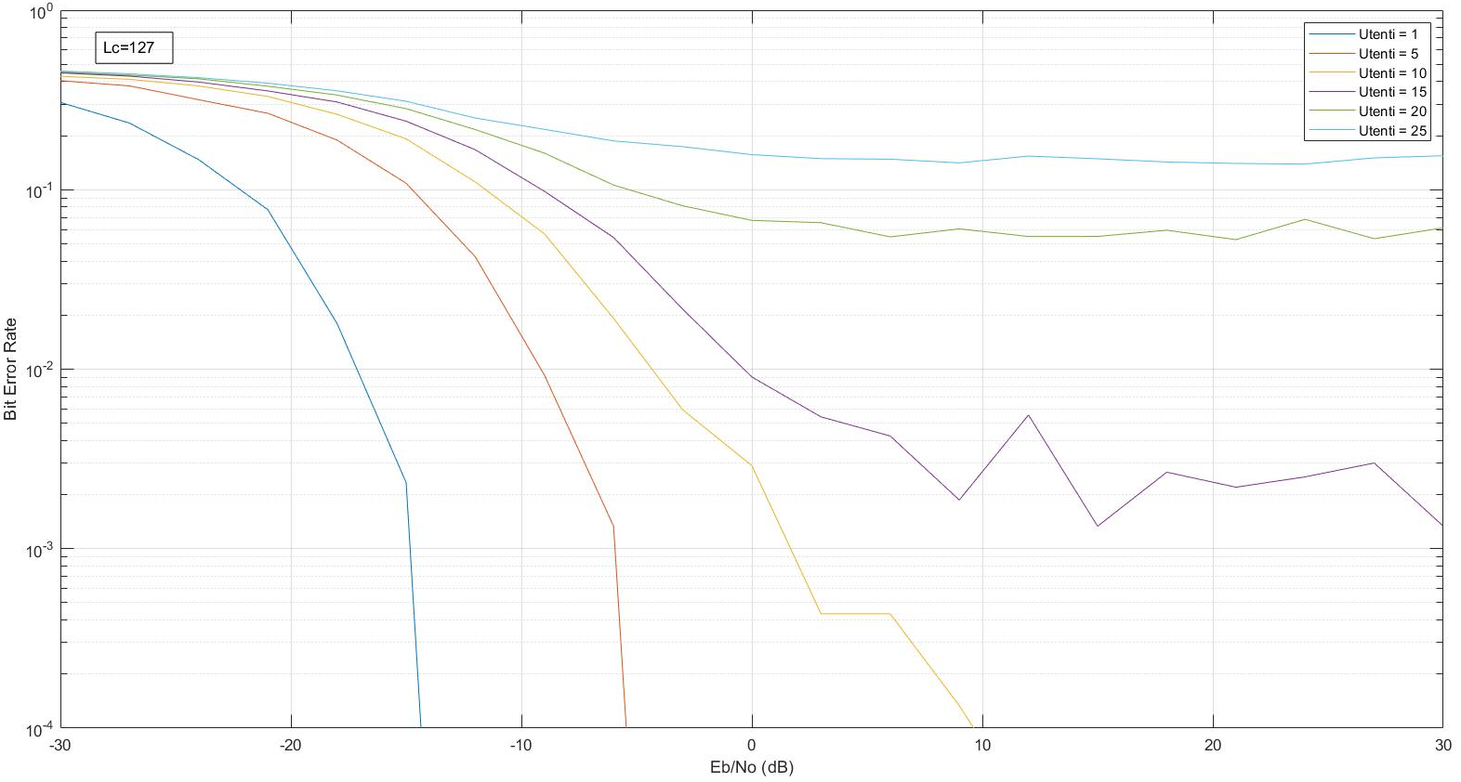

BER varying $E_{b}$/$N_{0}$ and #Users

Slide 12
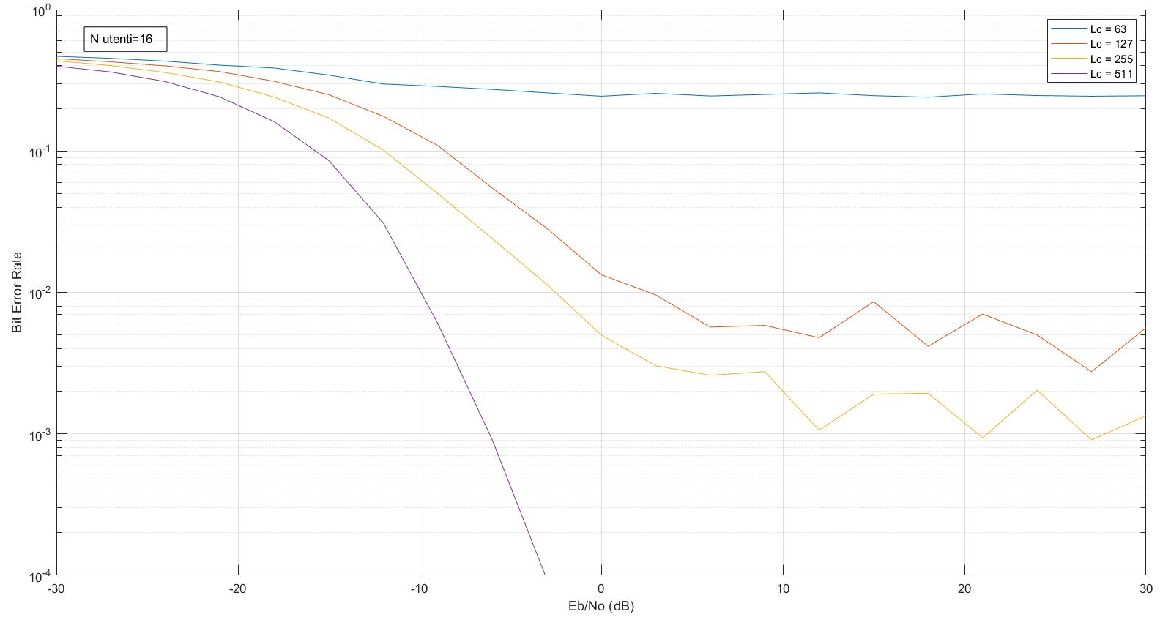

BER varying $E_{b}$/$N_{0}$ and $L_{c}$

Slide 13


Jamming
The word jamming identifies the action of transmitting an high power signal with the aim of interfere with existing communications changing SNR at receiver.
In the following slides Bit Error Rate (BER) for different jamming signals types in a CDMA communication system is shown.
Broadband Jammer
Tone Jammer
Single-Tone Jammer
Multi-Tone Jammer

Slide 14
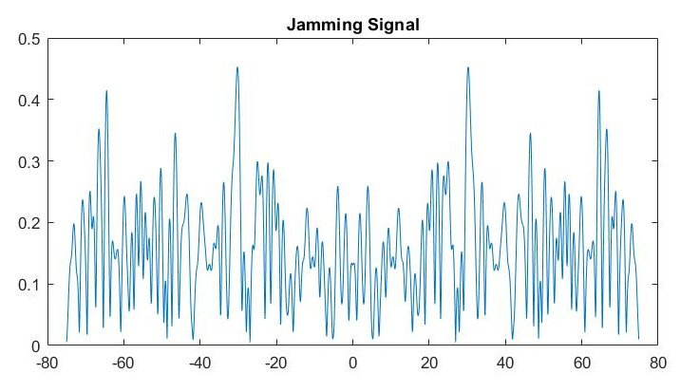
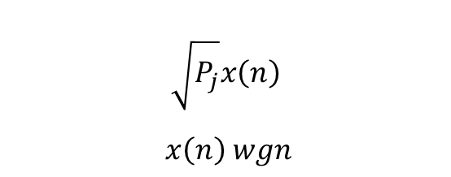
Broadband Jammer
Broadband or Barrage Jammer, models a white gaussian noise sequence with erogated power Pj.
$$\sqrt{P_{j}}x\left(n\right)$$
$x\left(n\right) wgn$

Slide 15
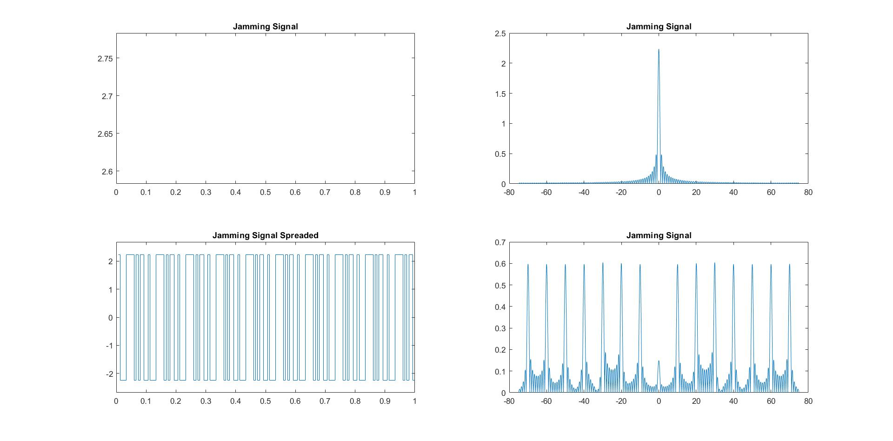
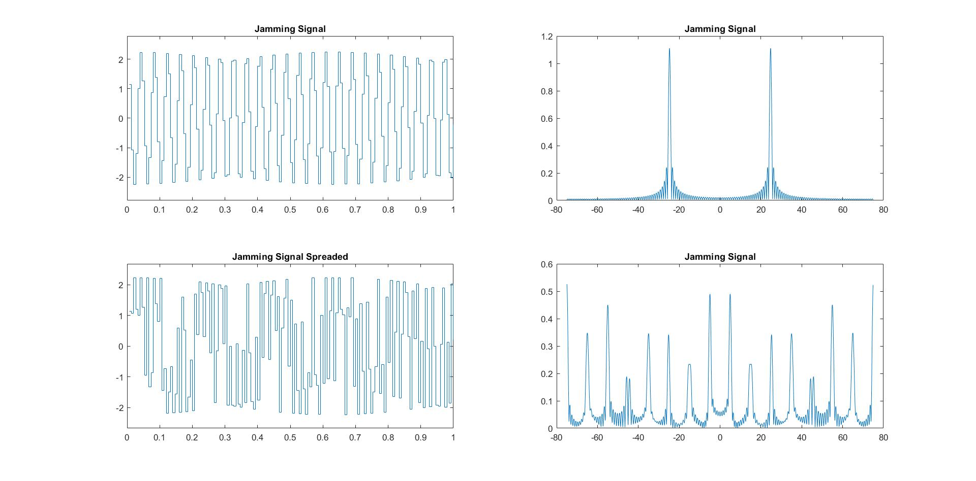


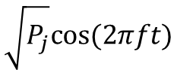
Single Tone Jammer
Single tone jammer represents a pulse centered at frequency $f$.
Figure shows a non modulated signal with power $P_{j}$ in the spreaded signal bandwidth.
$$\sqrt{P_{j}}cos⁡(2πft)$$
$$f=0$$
$$f≠0$$

Slide 16
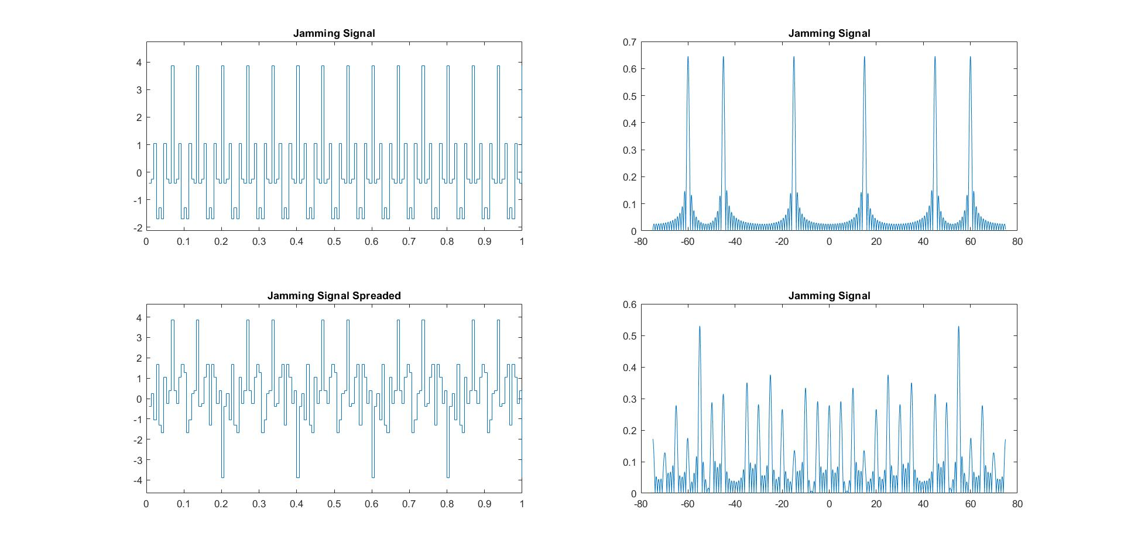
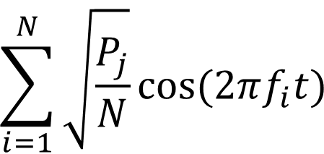
Multi Tone Jammer
Single tone jammer represents a pulse train centered at different frequencies.
Figure shows a non modulated signal with power $P_{j}$ in the spreaded signal bandwidth.
$$\sum_{i=1}^{N}{\sqrt{\frac{P_{j}}{N}}cos⁡(2πf_{i}t)}$$

Slide 17
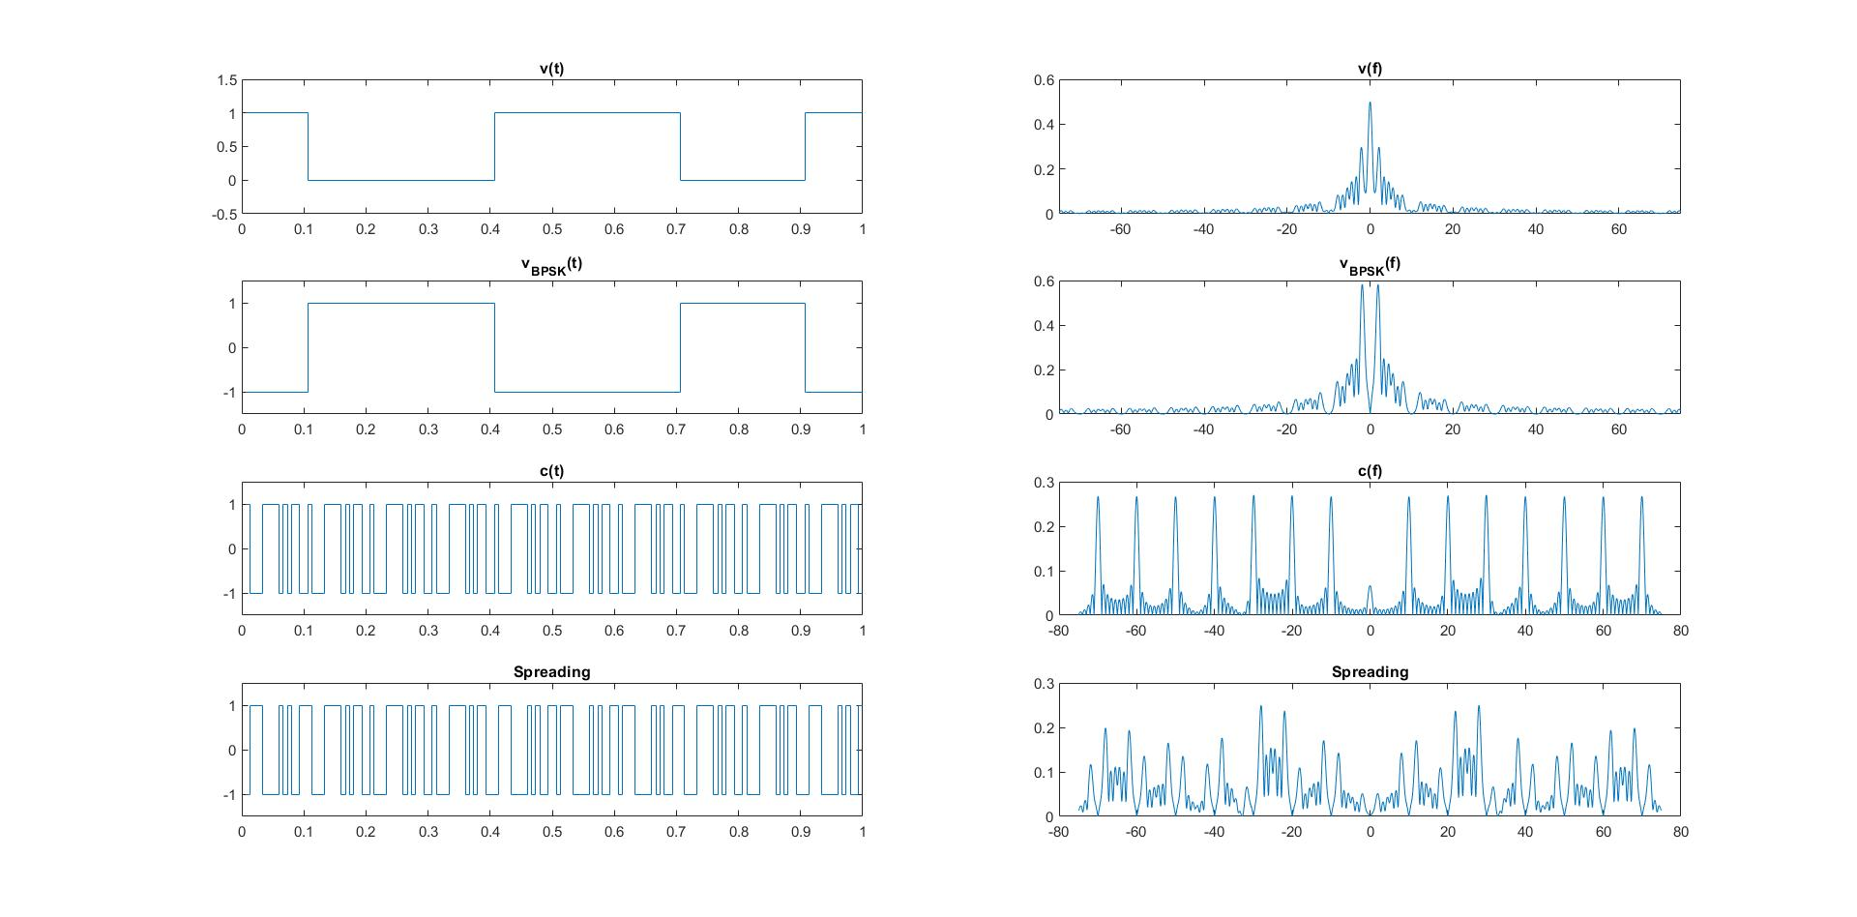
Single CDMA Transmission with Jamming
#User = 2
$$L_{c}=15$$

Slide 18
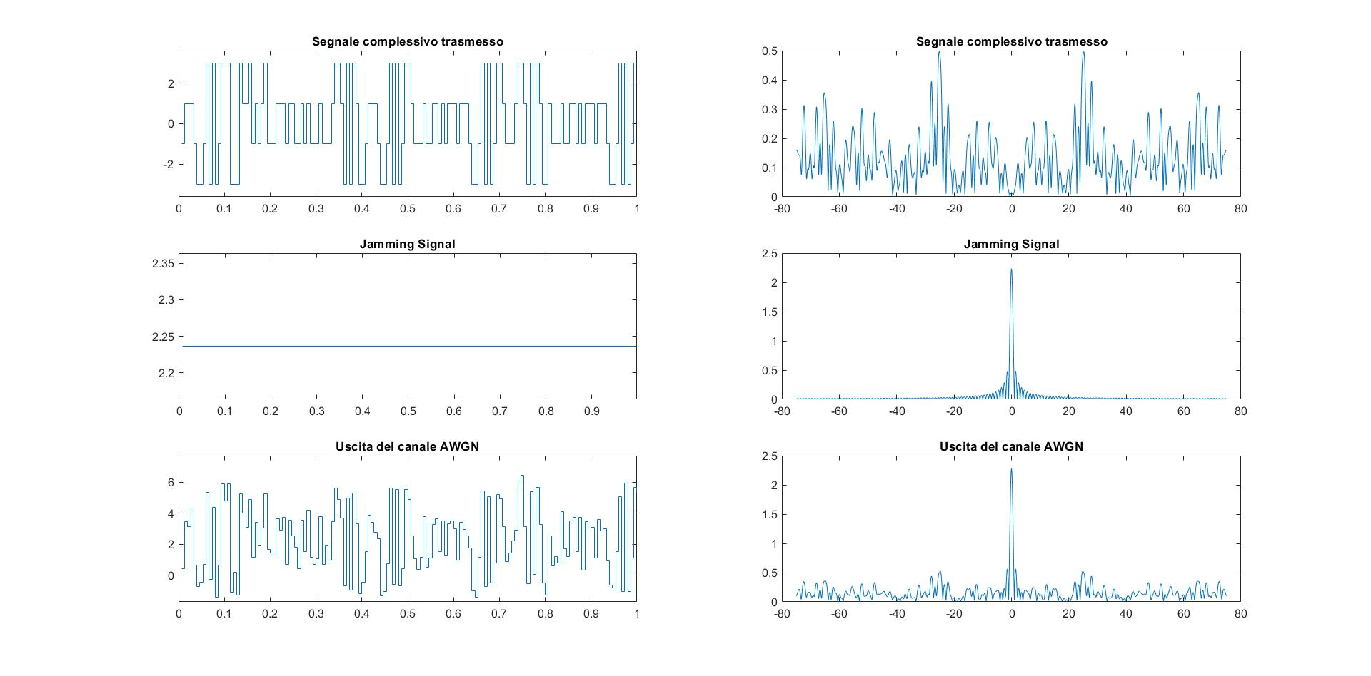
Single CDMA Transmission with Jamming
Jamming intensity = 5

Slide 19
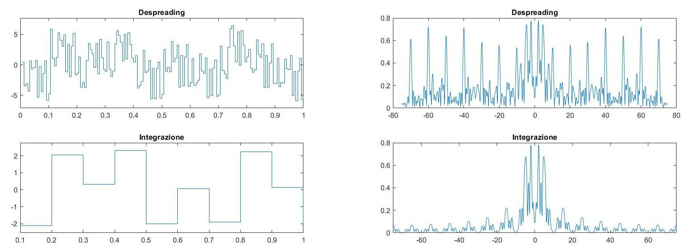
Single CDMA Transmission with Jamming

Slide 20
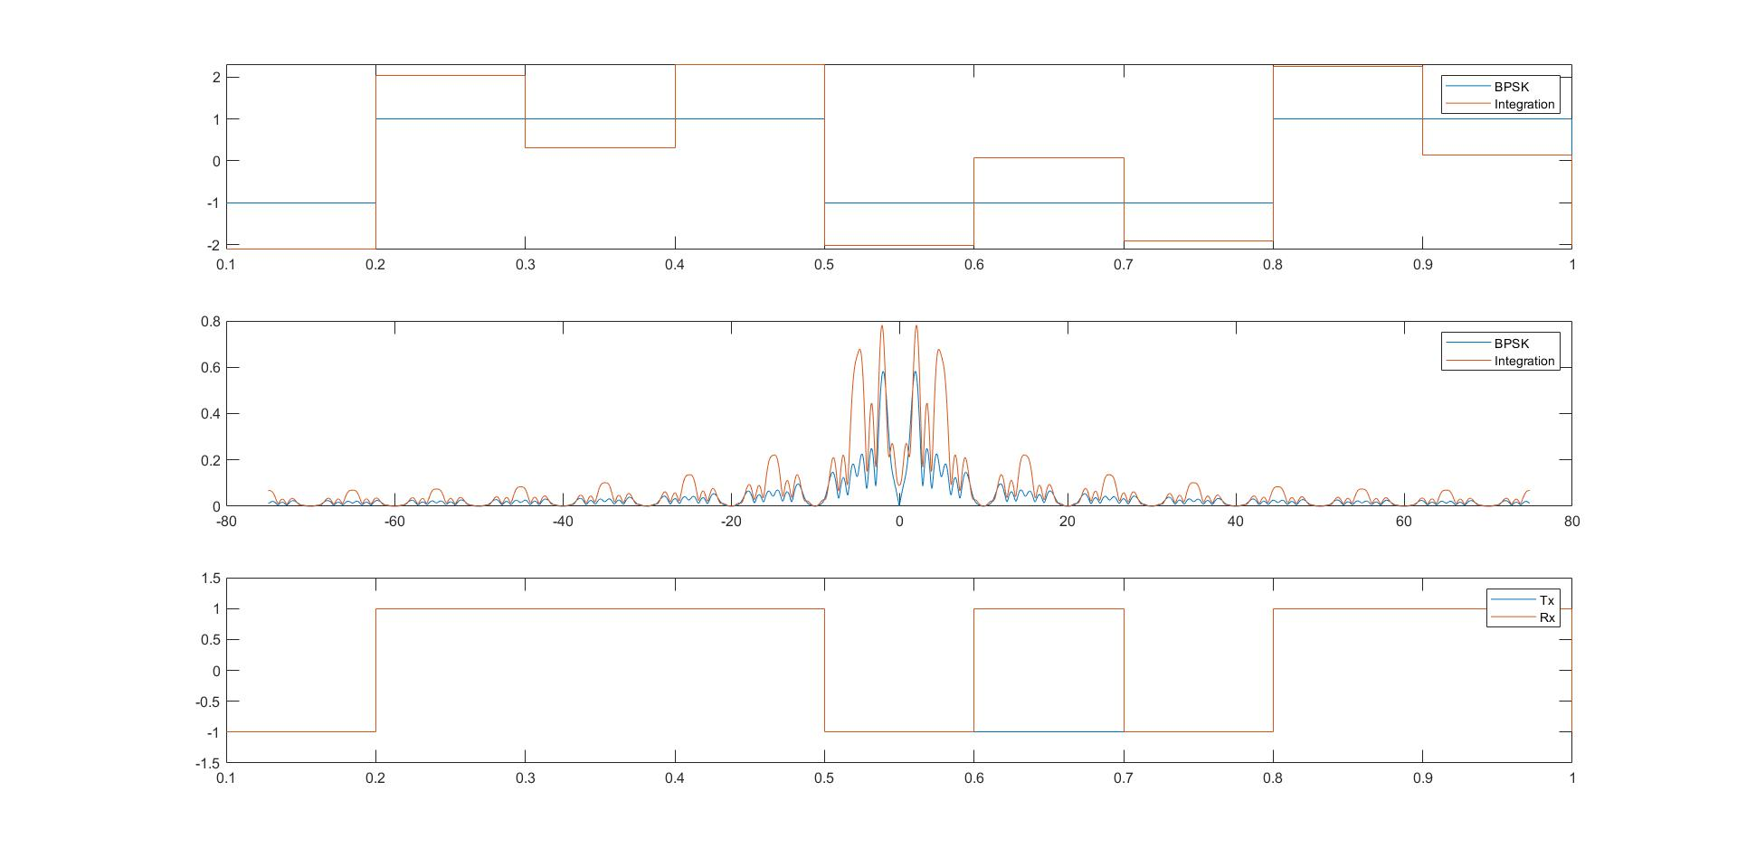
Single CDMA Transmission with Jamming

Slide 21
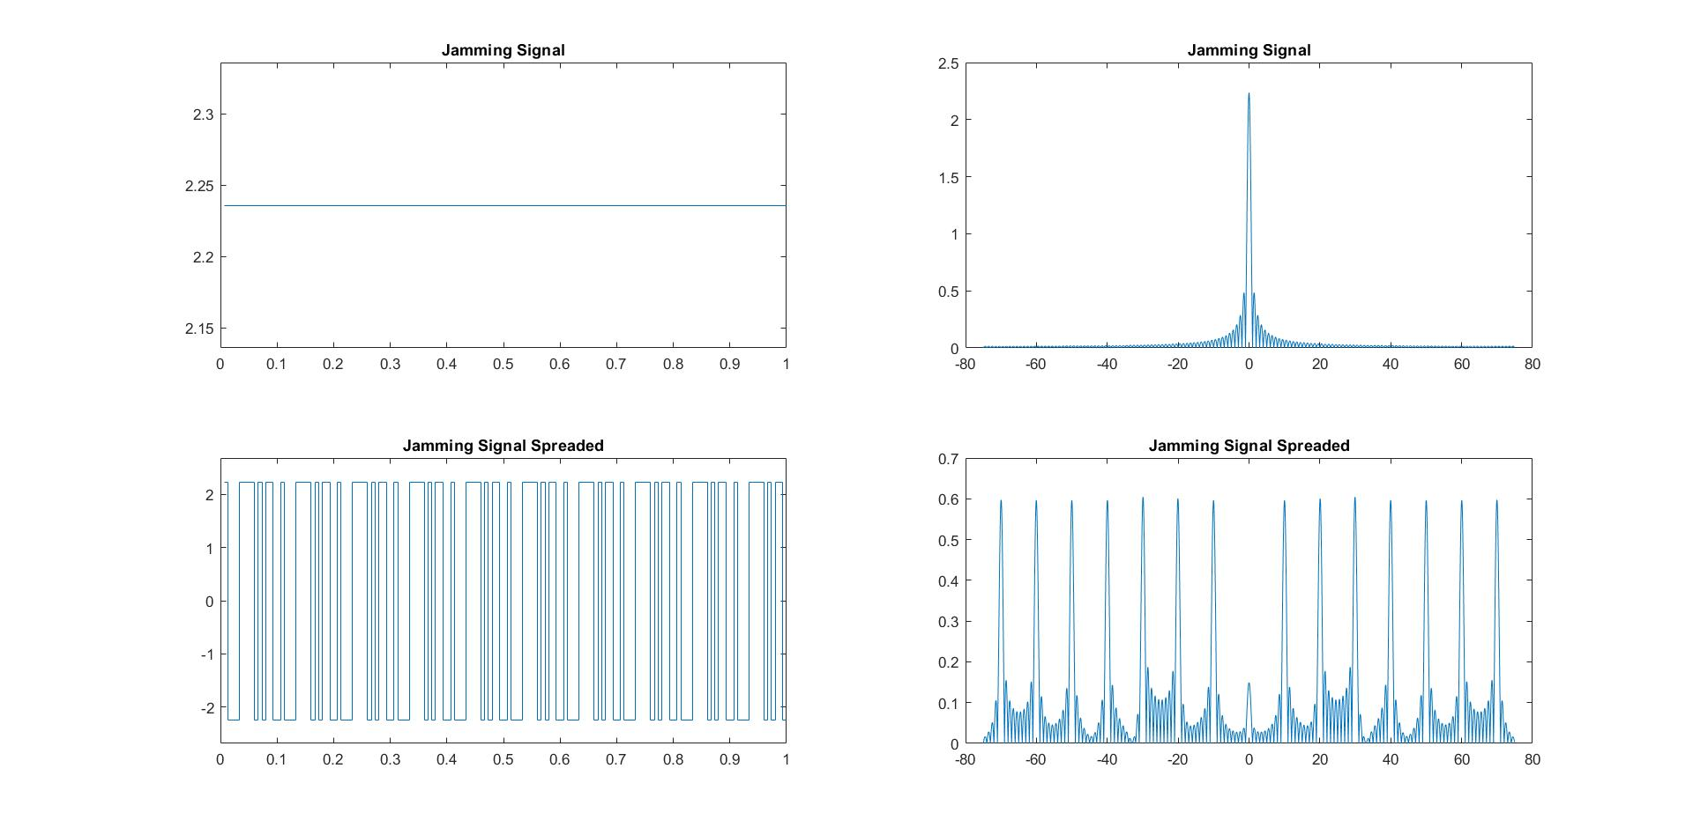
Single CDMA Transmission with Jamming

Slide 22
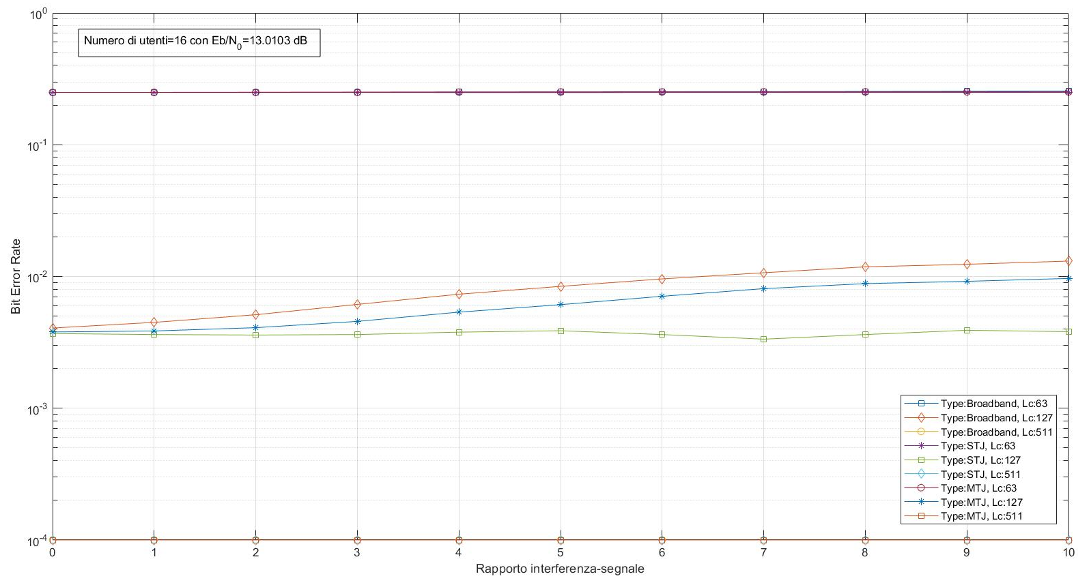
BER varying Jamming Intensity and Type

Slide 23
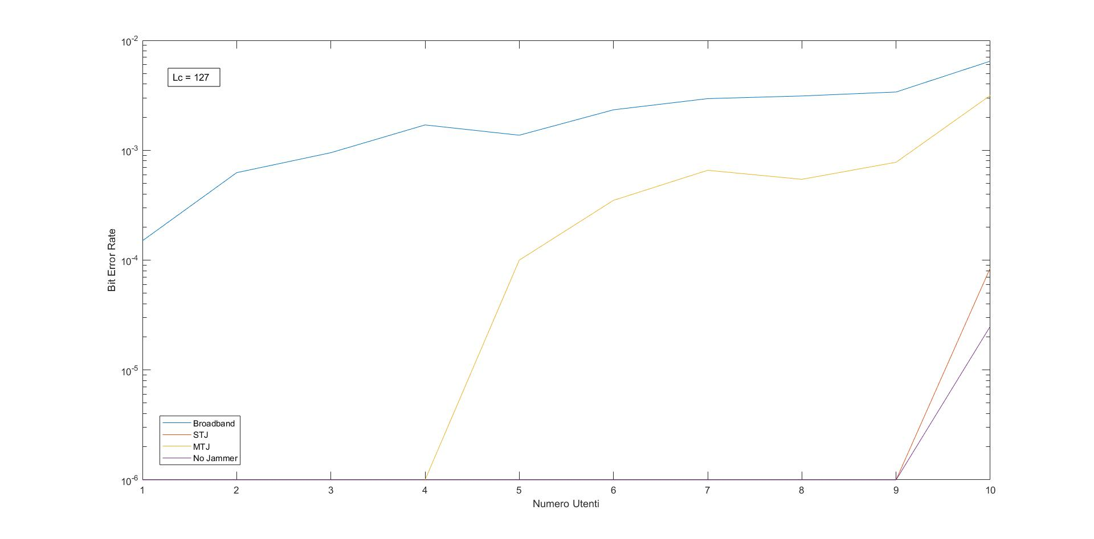
BER varying Jamming Type and #User
Jamming intensity = 10

Slide 24
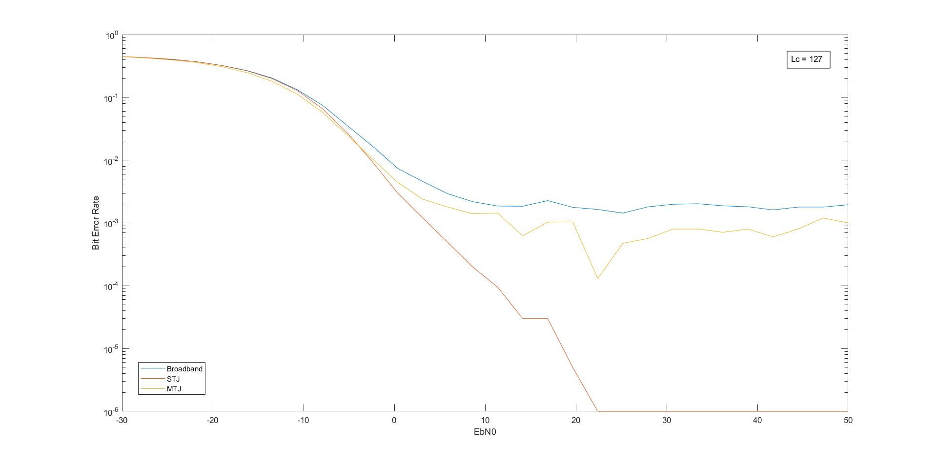
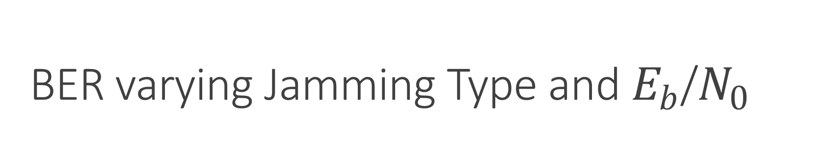
BER varying Jamming Type and $E_{b}$/$N_{0}$
Jamming intensity = 5
#Users = 16

Slide 25

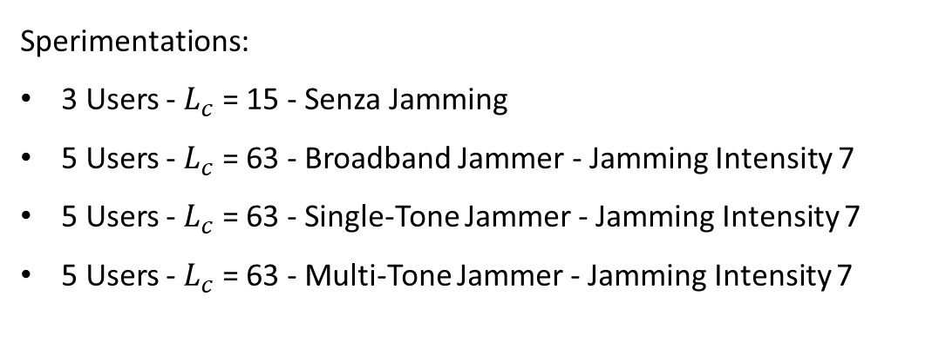
Audio Transmission
Audio samples used
Audio 1 | Audio 2 | Audio 3 | Audio 4 | Audio 5
Sperimentations:
3 Users - $L_{c}$ = 15 - Senza Jamming
5 Users - $L_{c}$ = 63 - Broadband Jammer - Jamming Intensity 7
5 Users - $L_{c}$ = 63 - Single-Tone Jammer - Jamming Intensity 7
5 Users - $L_{c}$ = 63 - Multi-Tone Jammer - Jamming Intensity 7

Slide 26
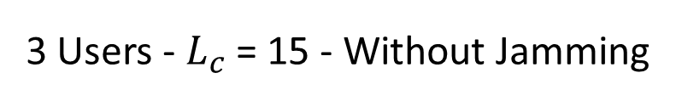
Audio Transmission
3 Users - $L_{c}$ = 15 - Without Jamming
Audio 1 Bit Error Rate 0.2505 – Symbol Error Rate 0.9819
Audio 2 Bit Error Rate 0.0000 – Symbol Error Rate 0.0000
Audio 3 Bit Error Rate 0.2502 – Symbol Error Rate 0.9820

Slide 27
Audio Transmission
5 Users - $L_{c}$ = 63 - Broadband Jammer - Jamming Intensity 7
Audio 1 Bit Error Rate 0.0065 – Symbol Error Rate 0.0985
Audio 2 Bit Error Rate 0.0085 – Symbol Error Rate 0.1262
Audio 3 Bit Error Rate 0.0066 – Symbol Error Rate 0.0998
Audio 4 Bit Error Rate 0.0017 – Symbol Error Rate 0.0272
Audio 5 Bit Error Rate 0. 0086 – Symbol Error Rate 0.1278

Slide 28
Audio Transmission
5 Users - $L_{c}$ = 63 - Multi-Tone Jammer - Jamming Intensity 7
Audio 1 Bit Error Rate 0.0022 – Symbol Error Rate 0.0350
Audio 2 Bit Error Rate 0.0000 – Symbol Error Rate 0.0002
Audio 3 Bit Error Rate 0.0000 – Symbol Error Rate 0.0001
Audio 4 Bit Error Rate 0.0000 – Symbol Error Rate 0.0000
Audio 5 Bit Error Rate 0. 0000 – Symbol Error Rate 0.0001

Slide 29
Audio Transmission
5 Users - $L_{c}$ = 63 - Single-Tone Jammer - Jamming Intensity 7
Audio 1 Bit Error Rate 0.0000 – Symbol Error Rate 0.0000
Audio 2 Bit Error Rate 0.0000 – Symbol Error Rate 0.0000
Audio 3 Bit Error Rate 0.0000 – Symbol Error Rate 0.0000
Audio 4 Bit Error Rate 0.0000 – Symbol Error Rate 0.0000
Audio 5 Bit Error Rate 0.0000 – Symbol Error Rate 0.0000

Slide 30
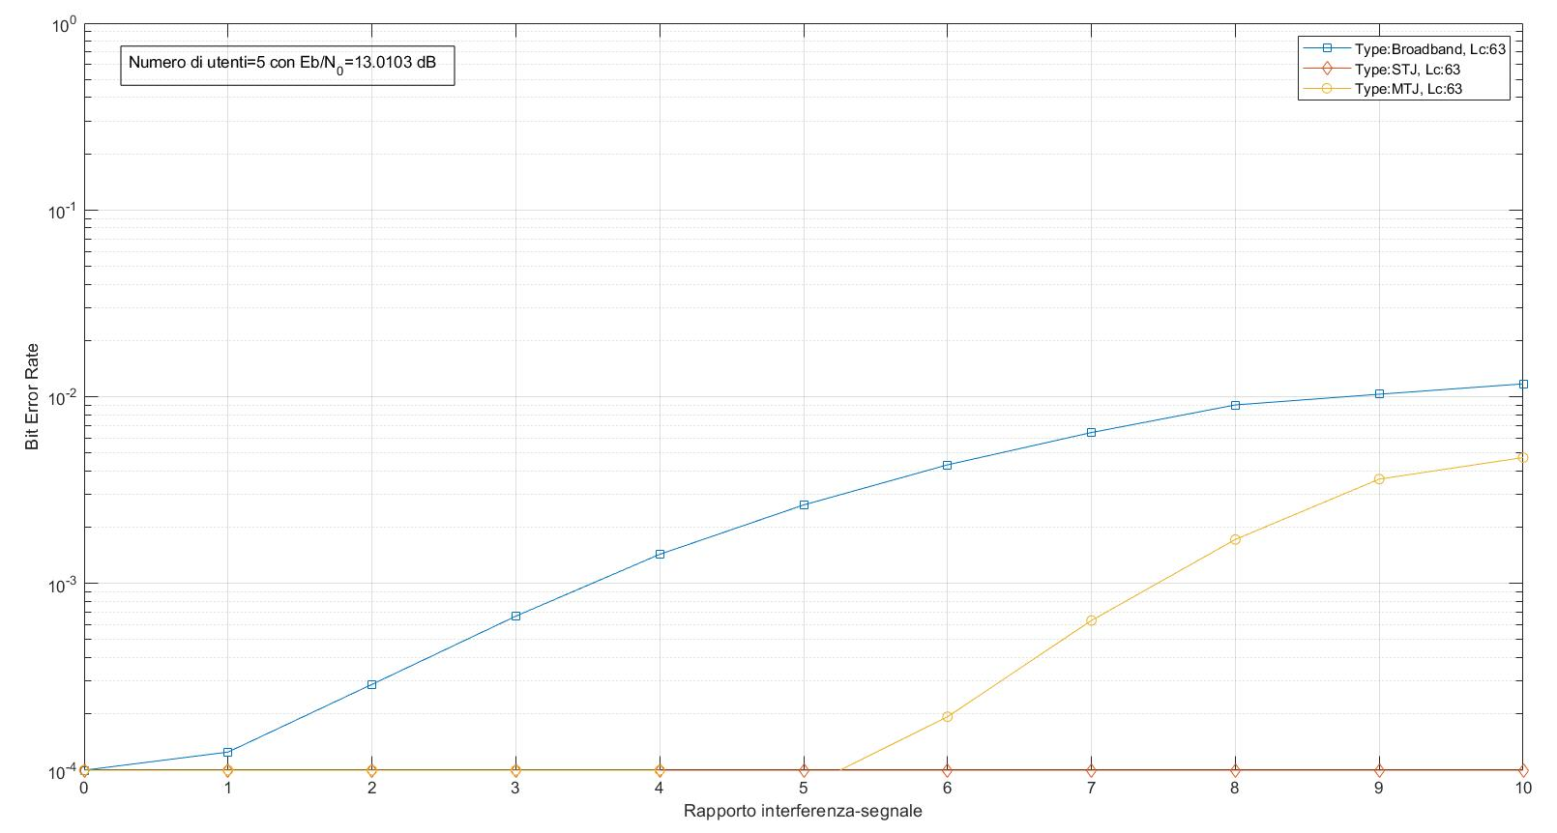
Audio Transmission

Slide 31
Queue Theory M/M/K

Slide 32
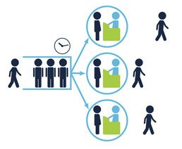
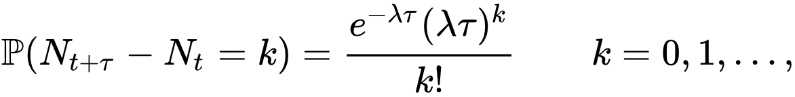
M/M/k
It is a single queueing station with multiple servers.
Customers arrive according to a Poisson process with rate λ.
The probability distribution of the service time is exponential with mean 1/μ sec.
A customer at the head of the queue is routed to any server that is available.

Slide 33
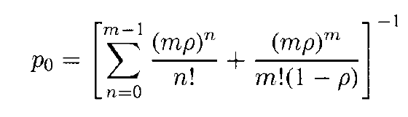
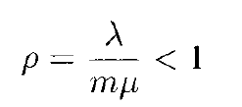
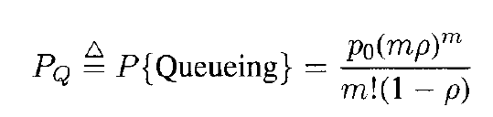
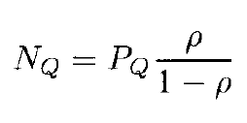
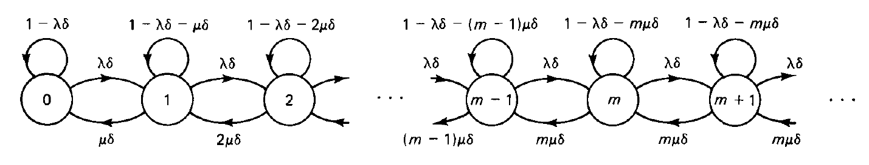
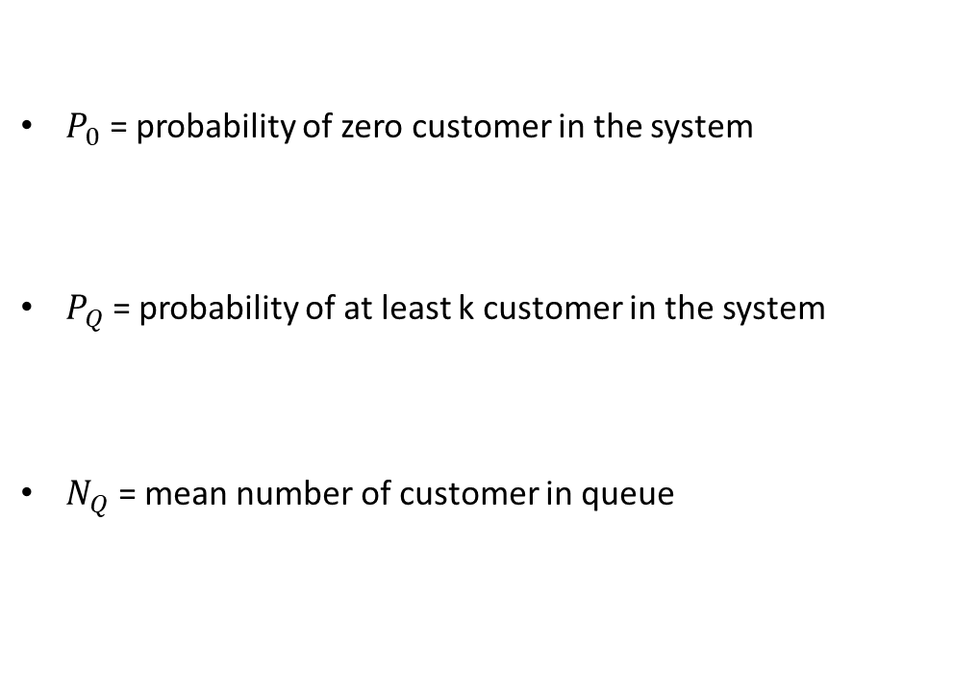
M/M/k
$P_{0}$ = probability of zero customer in the system
$P_{Q}$ = probability of at least k customer in the system
$N_{Q}$ = mean number of customer in queue

Slide 34
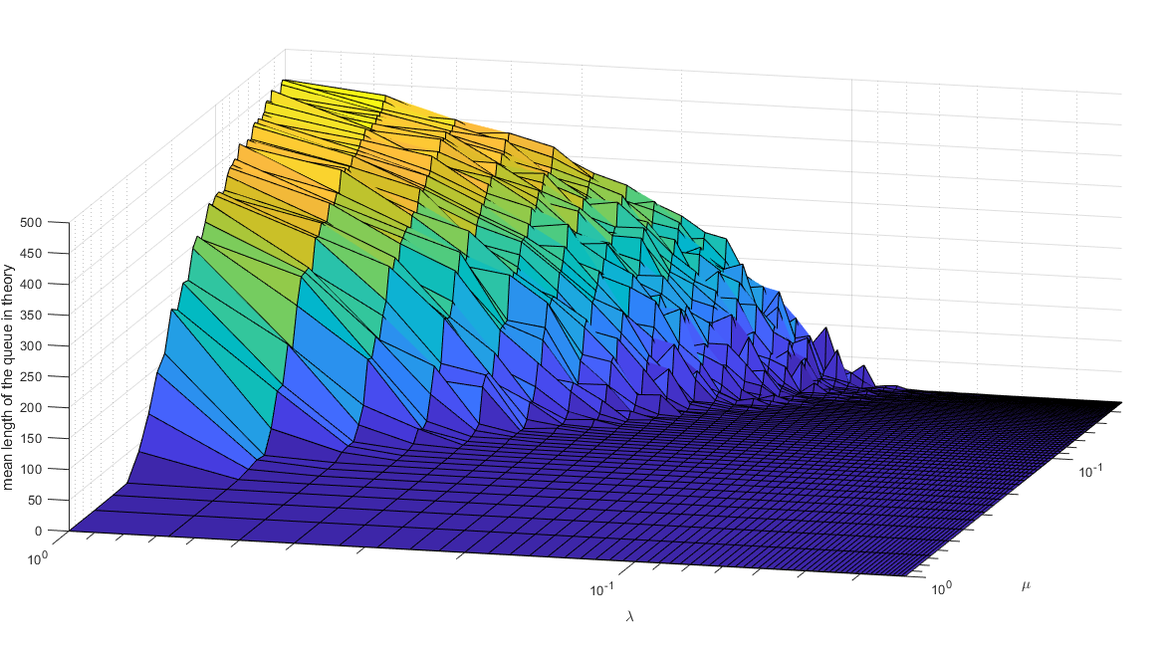
Simulation

Slide 35
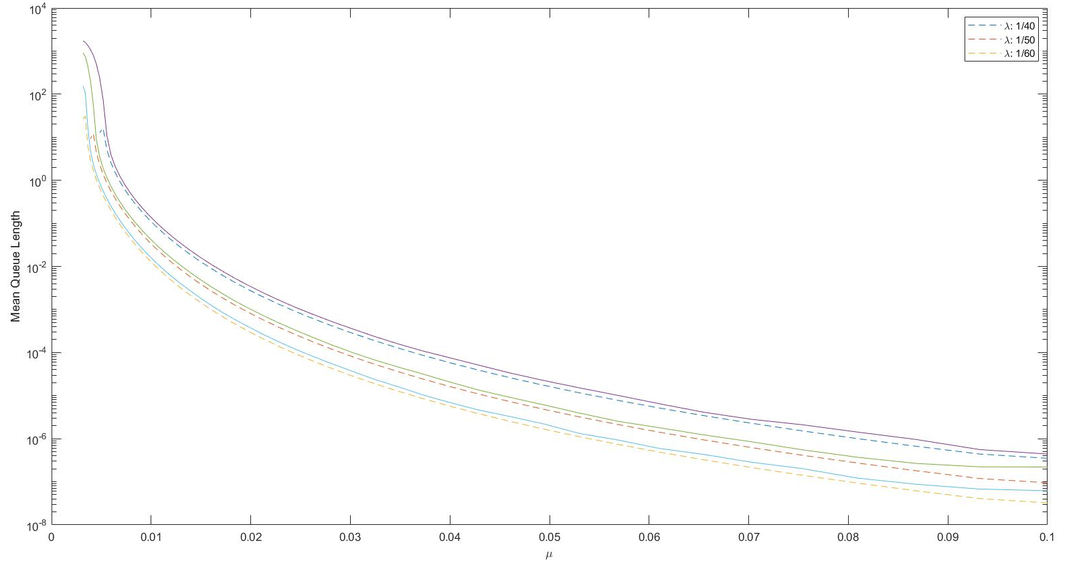
Simulation
Repetition = 1000
Packets = 10000
Servers = 5

Slide 36
THANKS!

